Slide 1


NextHikes IT Solutions Project 2
Data Harmonization and
Insights Extraction
Roshan Borde

Slide 2
Data Harmonization and Insights Extraction
Introduction:
The project explores the process of Data Harmonization and Insights Extraction using three datasets.
The first Dataset contains one numerical and other categorical features such as date, season, year, month, hour, holiday, weekday, and weather situation, alongside numerical columns including temperature and Second dataset contain amtemperature, humidity, windspeed, casual, registered and total number of rentals, Third dataset contain all columns as above including categorical and numerical along with additional rows.
This project is to transform raw data into actionable insights through a structured approach comprising three key phases: Data Acquisition, Data Wrangling, and Data Analysis.
In the Data Acquisition phase, datasets are loaded into Python for initial exploration using tools like .info(). Observations regarding data quality, completeness, and potential issues are documented to guide subsequent steps.

Slide 3
Introduction:
During Data Wrangling, the first task involves integrating Dataset_1 and Dataset_2 by merging them on common keys, handling missing values through imputation, and performing basic statistical analysis to evaluate central tendencies. Unnecessary columns and duplicates are removed to streamline the data. The second task involves integrating Dataset_3 by concatenating it with the existing dataset, followed by a detailed analysis of missing values, outliers, and applying statistical methods to address these issues effectively.
Finally, in the Data Analysis phase, advanced statistical methods are employed. Skewness in numerical attributes is analyzed, correlations between features are computed, and key insights are visualized using heatmaps, scatter plots, and boxplots. This process ensures harmonized, high-quality data and enables the extraction of meaningful insights for informed decision-making.

Slide 4
Objectives:
Gain hands-on experience in cleaning, merging, and wrangling complex datasets to ensure consistency and accuracy.
Develop proficiency in applying exploratory data analysis (EDA) techniques to uncover patterns, trends, and irregularities in the data.
Effectively handle missing values, outliers, and other data quality issues using appropriate statistical and analytical methods.
Prepare datasets for advanced modeling by normalizing, transforming, and integrating diverse data sources.
Enable the creation of actionable insights to support real-world business use cases and decision-making processes.

Slide 5

Data wrangling and cleaning steps:
A. Libraries Imported
Utilized pandas, NumPy, matplotlib, seaborn for data manipulation and visualization.
B. Data Loading and Exploration
Data loaded into Python using pandas.
Displayed first few rows using .head() to understand structure.
Checked data types and summary using .info().
C. Data Type Adjustments
Converted categorical columns which are misclassified as float or int to appropriate category type.
D. Dataset Dimensions
Verified dataset size using .shape (rows, columns).

Slide 6

Data wrangling and cleaning steps:
E. Handling Missing Values
Identified missing values using .isnull().
Filled missing numerical values with mean/median.
Filled missing categorical values with mode.
F. Removing Duplicates and Unnecessary Columns
Removed duplicate entries using .duplicated().
Dropped irrelevant columns using .drop().
G. Outlier Detection and Treatment
Identified outliers using box plots.
Calculated Interquartile Range (IQR) to define thresholds for outliers
Applied capping using np.where to handle extreme values.

Slide 7
Key challenges and addressed.
Understanding the Data: Gaining a clear understanding of each columns and identify type of data, categorical or numerical, it was challenging without proper studies.
Integration of Multiple Datasets: Merging datasets with different datasets based on key column again required a deep understanding of the data and proficiency in manipulation skills.
Data Quality Issues: By integrating data from different dataset was included missing values and outliers. By filling and capping a missing value and outliers respectively was not easy by using appropriate cleaning and imputation techniques.
Interpreting Insights: Translating raw data into meaningful insights by using various visualization plot for business use cases required statistics, technical and domain knowledge.
Tool Proficiency: Mastering Python libraries and visualization tools, especially for Explorery Data Analysis (EDA) was required huge research and study when dealing with multiple columns.

Slide 8
Insights from the dataset.
The dataset regarding to rental service provided by company and how other factor is going to influence it need to check.
It contains Categorical columns like dteday(Date), season, yr(Year), mnth(Month), hr(Hour), holiday, weekday and weathersit(weather situation) and Numerical Columns like temp (temperature), atemp, hum (humidity), windspeed, casual, registered and cnt (Total number of rental).
The columns, cnt (Total number of rental) is a target column and other columns are a feature columns.
The cnt (Total number of rental) column is depended on other columns, like dependent and independent variable.

Slide 9
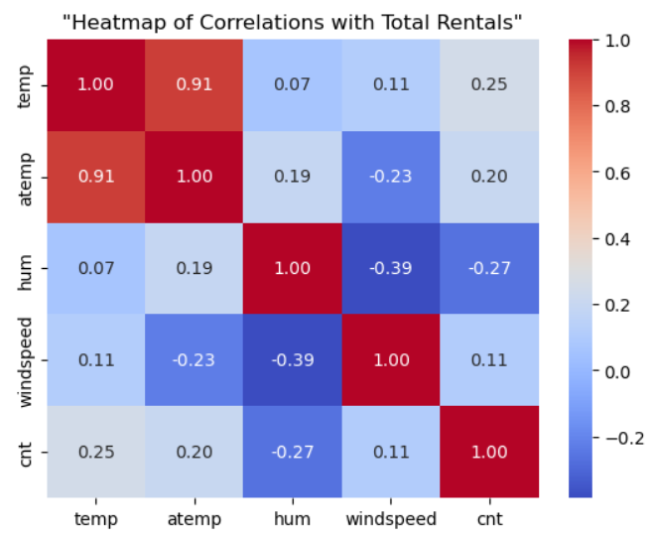
Findings from the dataset.
By Observing Correlation between Numerical Columns and cnt (Total number of rental):-
it came to know that temp, atemp and windspeed have a positive correlations with cnt (Total numner of rental). Humidity has a negative correlations with cnt (Total number of rental).
Conclusion: if temp, atemp, windspeed are increased then cnt (Total numner of rental) also increases but in context of hum (humidity), cnt (Total number of rental) increases when hum (humidity) decreases.

Slide 10
Findings from the dataset
By Observing Correaltion between categorical columns and cnt (Total numner of rental):-
it came to know that mnth specially 2nd i.e. february has more number of rental as compare to 1st mnth i.e. January.
In hr(hours) column, morning 7,8 and 9 and eveining 17,18,and 19 have a highest number of rental.
By considering a holyday column, it came to know that working days have more number of rental as compare to holyday.
By Analysing weekday column(if'0' is considered as a Sunday) in Tuesday people have taken highest number of rental service followed bt Thursday and Friday.
In weathersit(weather situation) 1:Clear, Few clouds, Partly cloudy, Partly cloudy, 2: Mist + Cloudy, Mist + Broken clouds, Mist + Few clouds, Mist, # 3: Light Snow, Light Rain + Thunderstorm + Scattered clouds, Light Rain +Scattered clouds have more rental service as compare to 4: Heavy Rain + Ice Pallets + Thunderstorm + Mist, Snow + Fog.
Conclusion: All categorical data are also affected to cnt (Total numner of rental), it increases or decreases according to data.

Slide 11

Thank You

